Slide 1
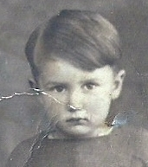
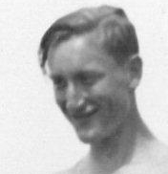
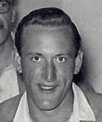
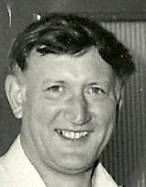
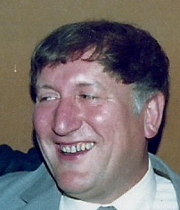
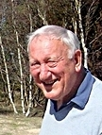
Good Evening and Welcome To:
John Lethaby’s 80th Birthday Celebration

Slide 2
We Shall Begin at Childhood

Slide 3
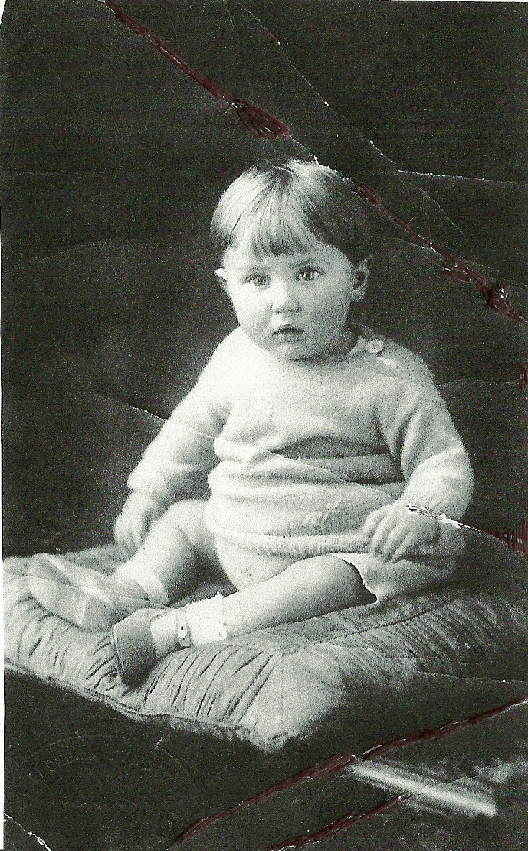
The first ever PBS (Pudding Bowl Special) hairstyle

Slide 4
I’m going to pull his head off!!
Please don’t old chap, it hurts!

Slide 5
Known as the Fuhrer Fringe, this haircut was quite popular
until Germany waltzed in to Poland in 1939

Slide 9
Into Adulthood

Slide 13
C&A Spring/Summer Collection
1959

Slide 16
Marriage

Slide 20
Children-in Order of Worst Haircut

Slide 21
In Fifth Place.....

Slide 22
Lorna!!!

Slide 23
In Fourth Place.....

Slide 24
Graham

Slide 25
In Third Place.....

Slide 26
Bruce!

Slide 27
In Second Place.....

Slide 28
Bob!!

Slide 29
And the winner is....

Slide 30
Sarah!

Slide 32
Sporting Activity

Slide 35
Hiking....

Slide 39
What happened next?

Slide 40
Canoeing &Biking.......

Slide 43
Eating.......

Slide 47
And...boozing

Slide 53
.......Followed by Snoozing

Slide 55
And Finally- The Embarrassing Ones

Slide 56
Do you like my new trunks?
Good grief old chap is that a budgie down there?
Goodness me...look the other way darling!

Slide 58
Oooh my Gawd...he’s turned in to an iron hoof!

